Slide 1
MAP-ID BENGALURU
MUSASHI RULES TRAINING
TOPIC : PROCEDURE & RULES TO FOLLOW

Slide 2
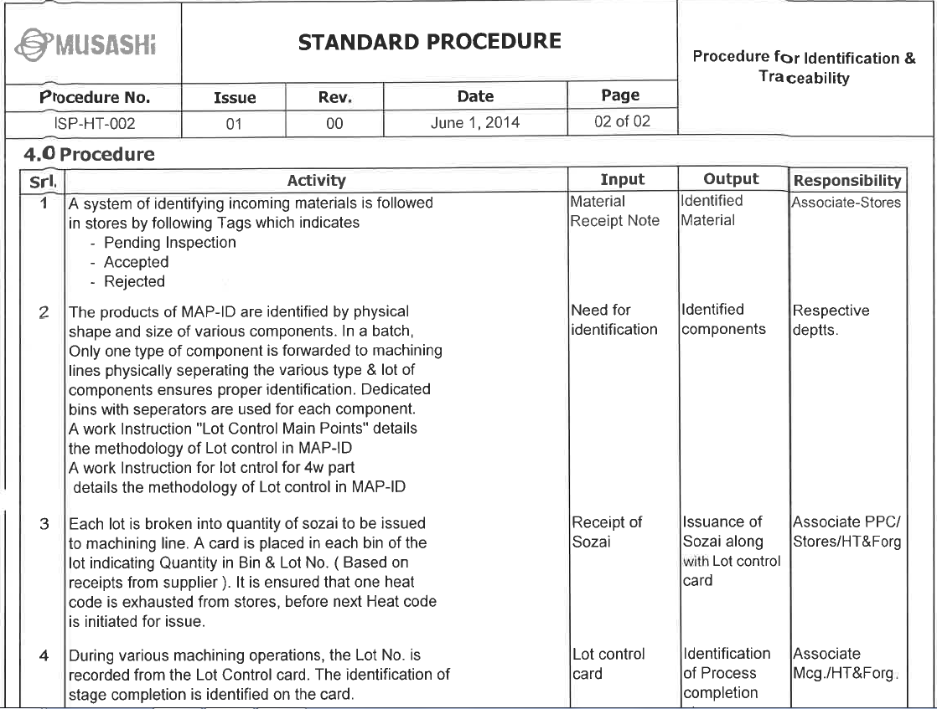
PROCEDURE FOR IDENTIFICATION & TRACEABILITY

Slide 3
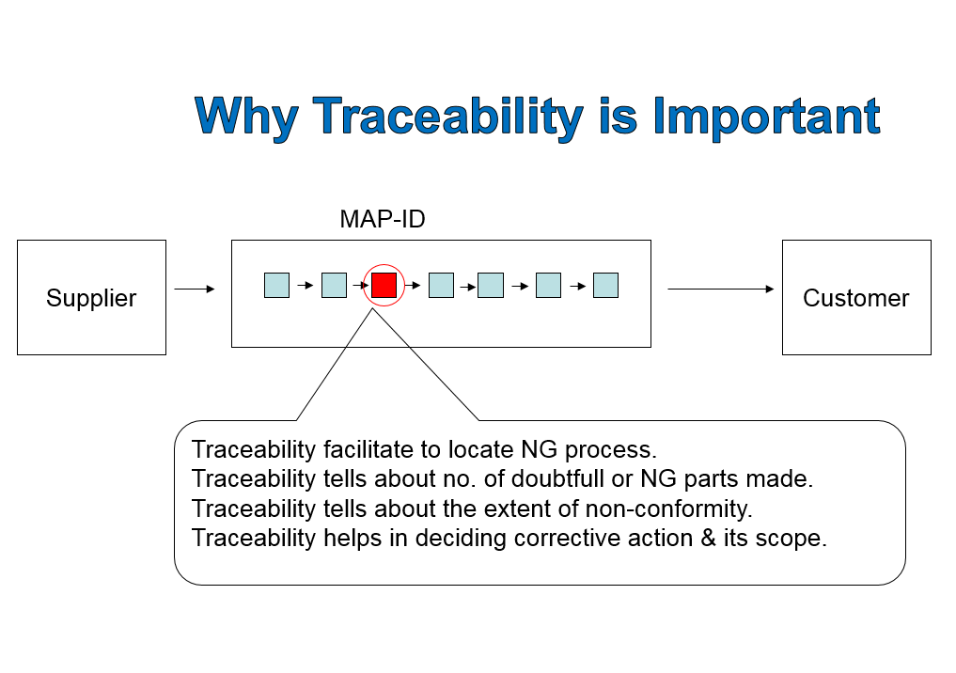
LOT TRACEABILITY

Slide 4
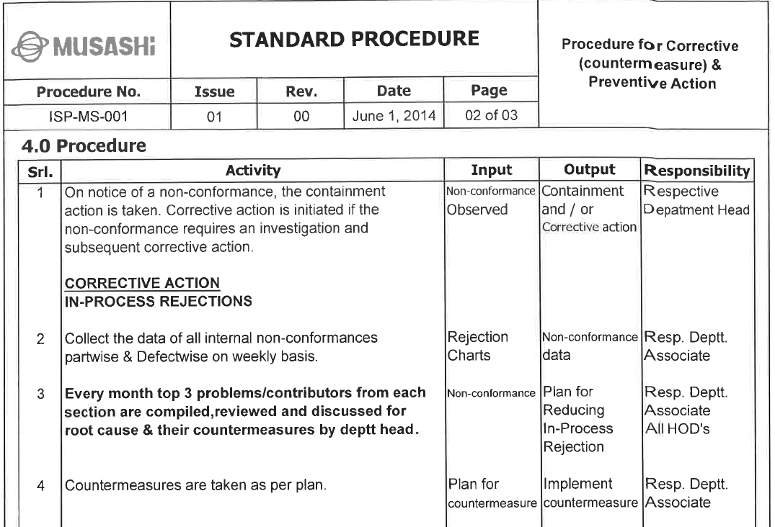
PROCEDURE FOR CORRECTIVE (COUNTERMEASURE)

Slide 5
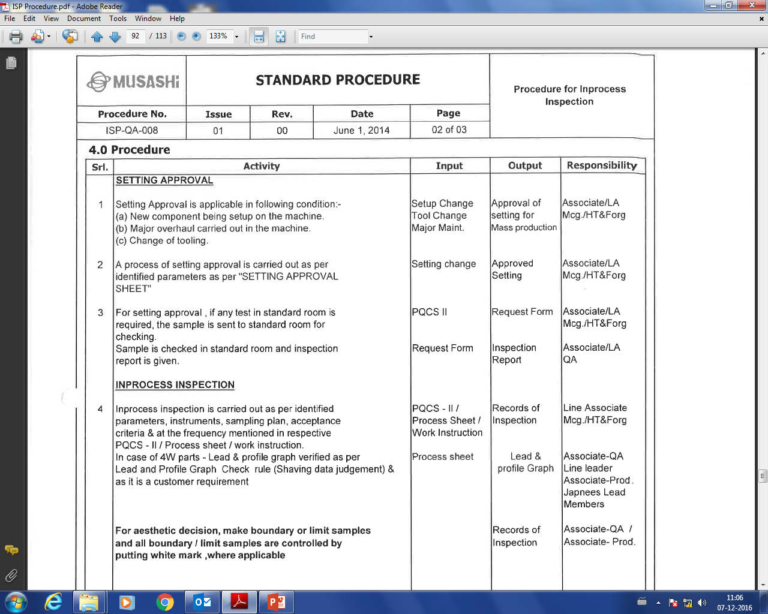
PROCEDURE FOR INPROCESS INSPECTION

Slide 6
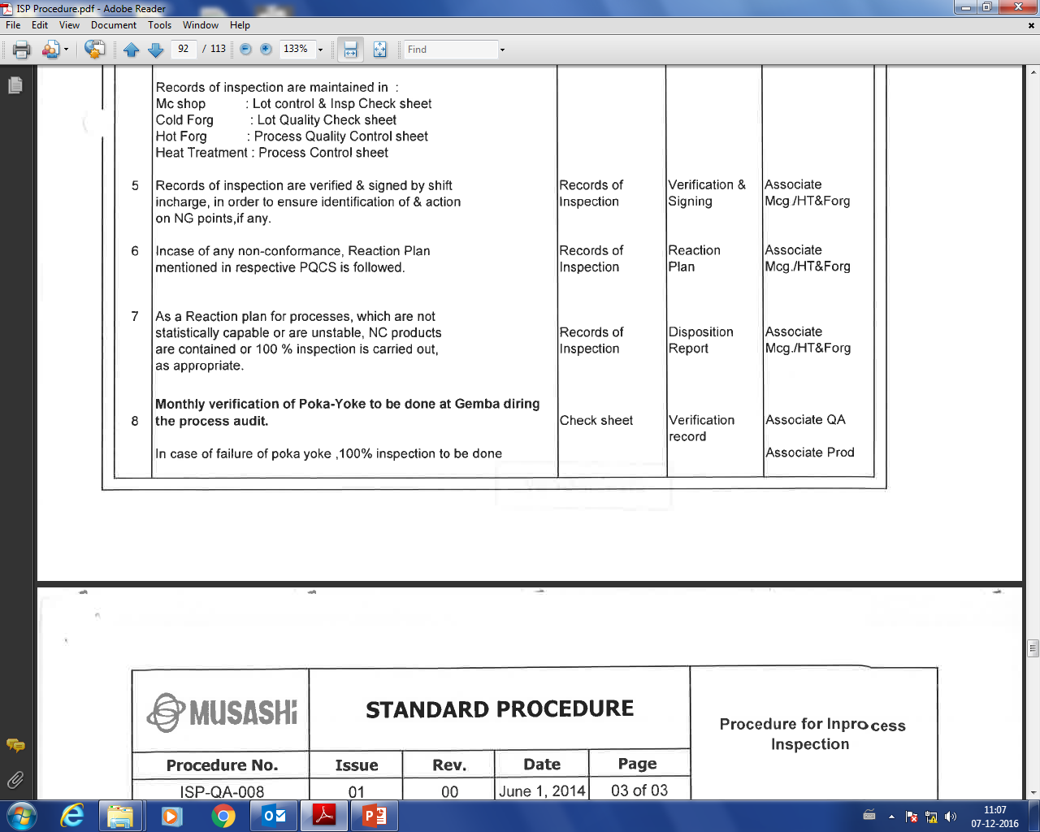
PROCEDURE FOR INPROCESS INSPECTION

Slide 7
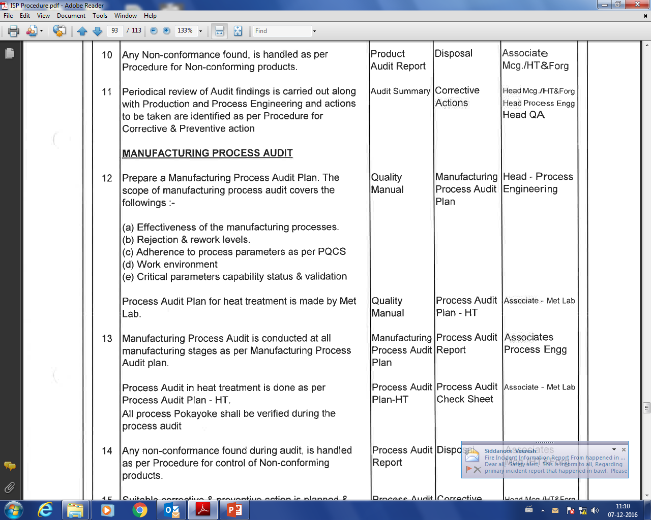
PROCEDURE FOR INPROCESS INSPECTION

Slide 8
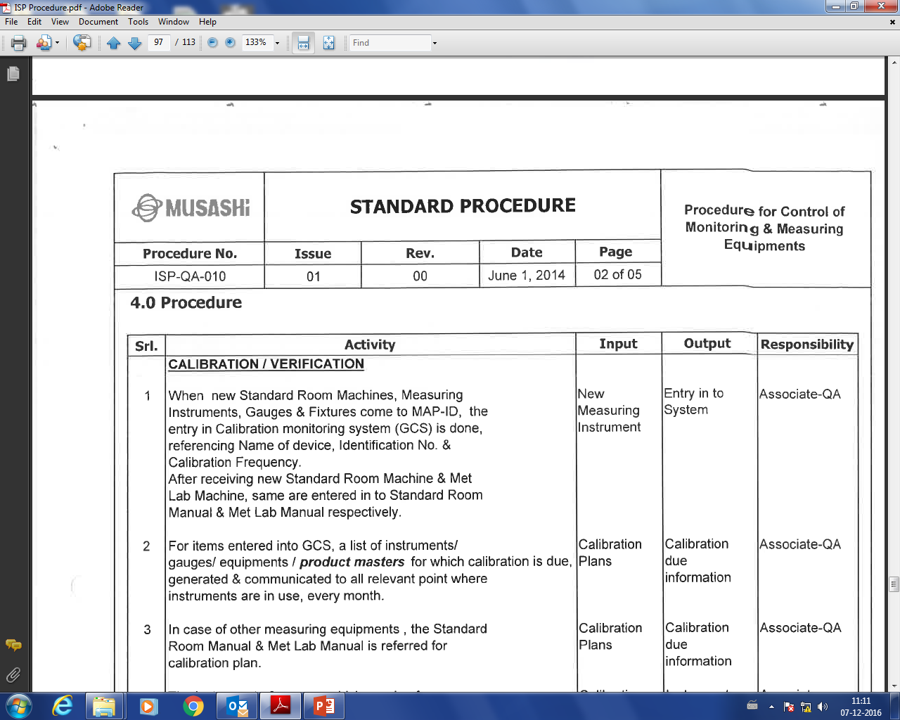
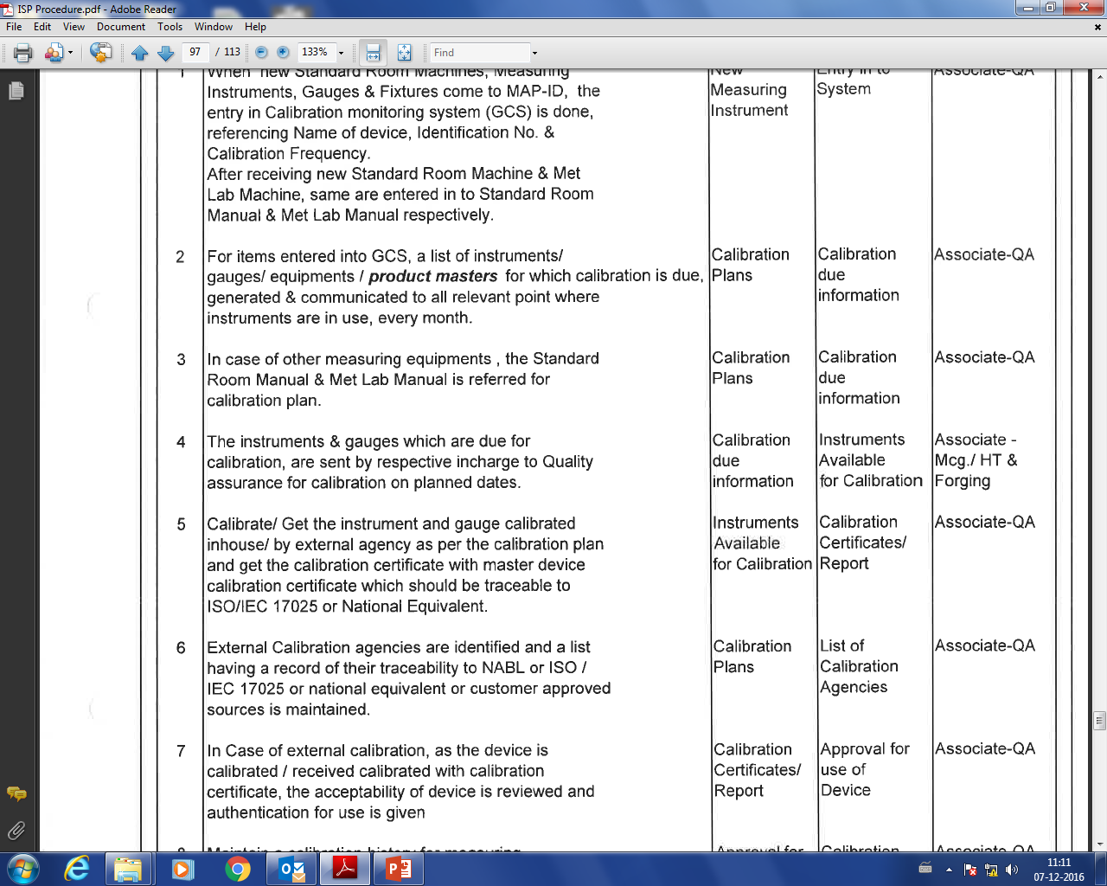
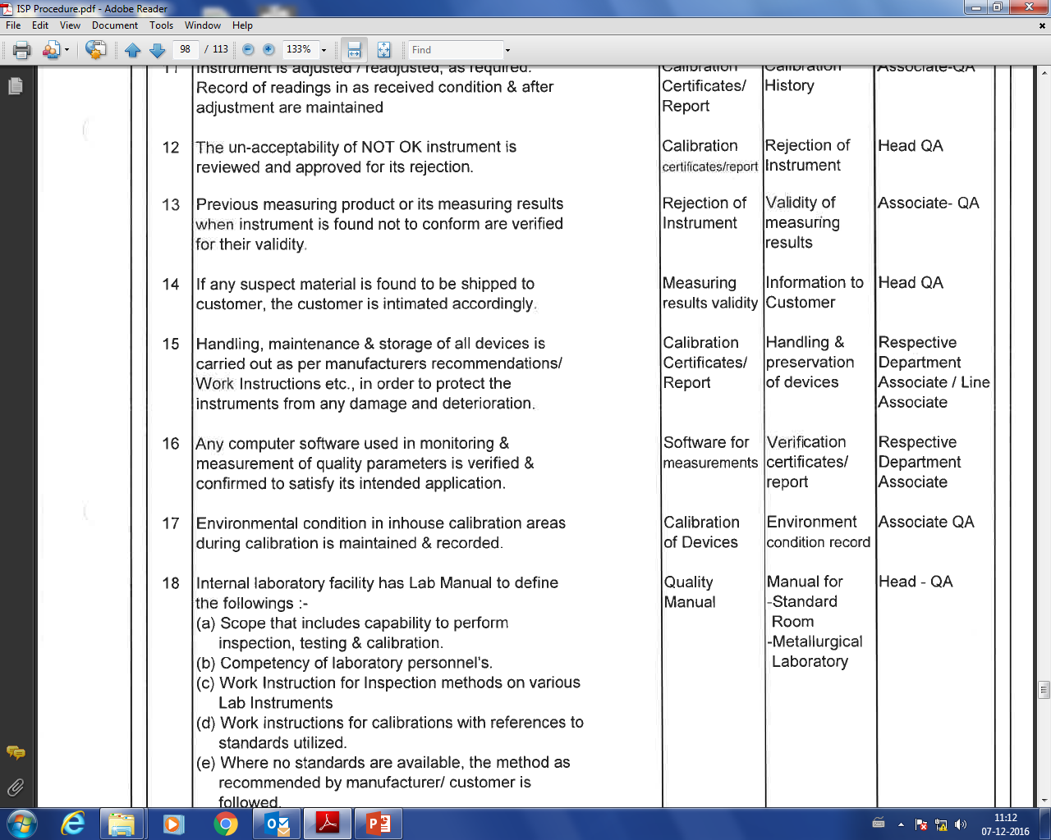
PROCEDURE FOR CONTROL OF MONITORING & MEASURING EQUIPMENTS

Slide 9
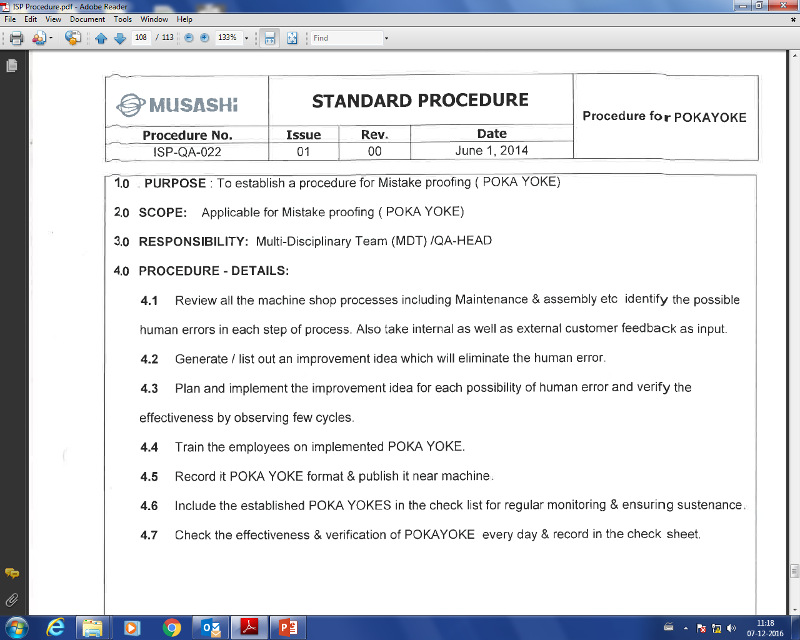

PROCEDURE FOR POKAYOKE

Slide 10
IPP – Initial Production Part

Slide 11
IPP – Initial Production Part

Slide 12
IPP – Initial Production Part

Slide 13
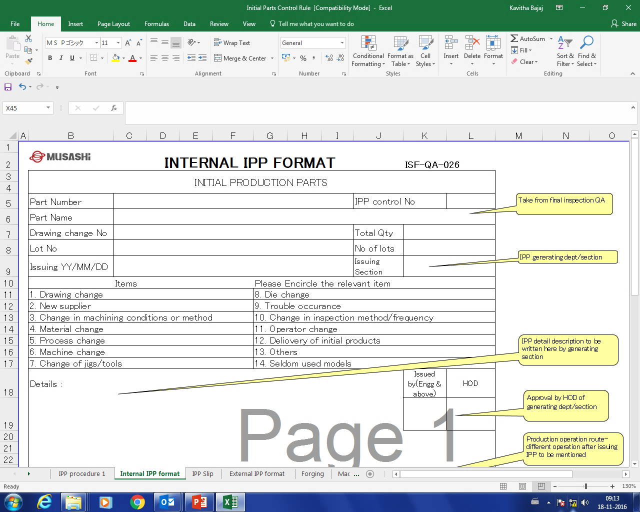
IPP – Initial Production Part

Slide 14
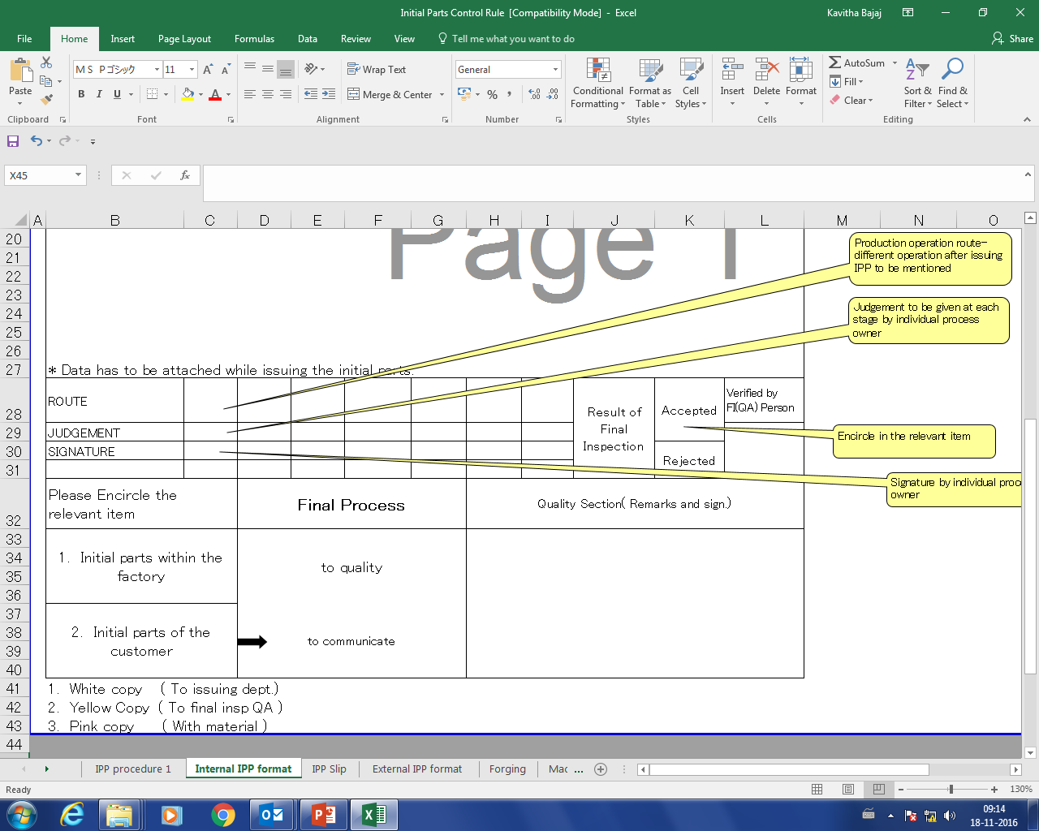
IPP – Initial Production Part

Slide 15
IPP – Initial Production Part

Slide 16
IPP – Initial Production Part

Slide 17
IPP – Initial Production Part

Slide 18
IPP – Initial Production Part

Slide 19
IPP – Initial Production Part

Slide 20
IPP – Initial Production Part

Slide 21
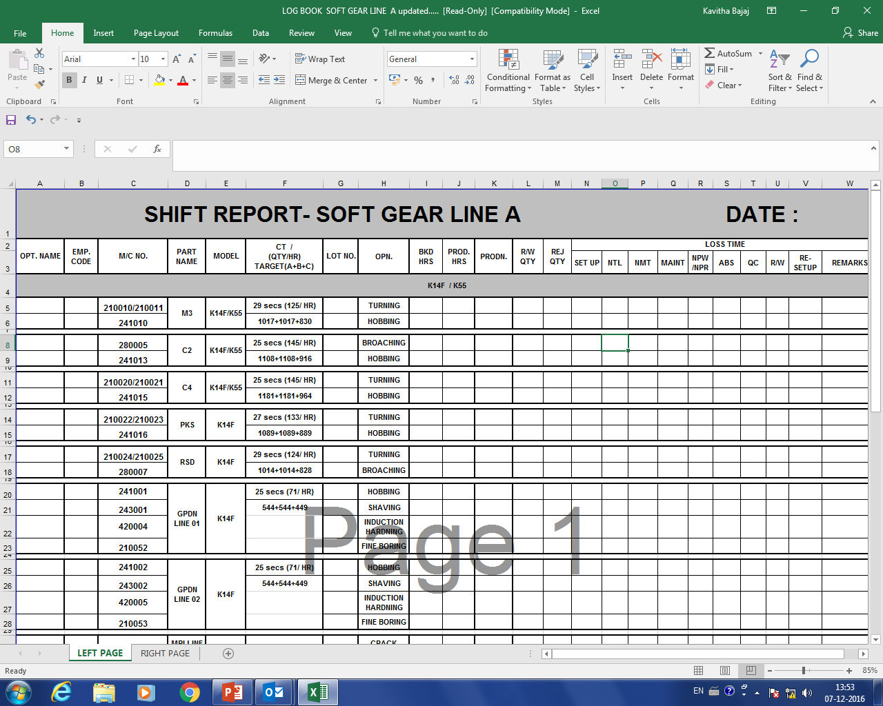
LOG BOOK ENTRY

Slide 22
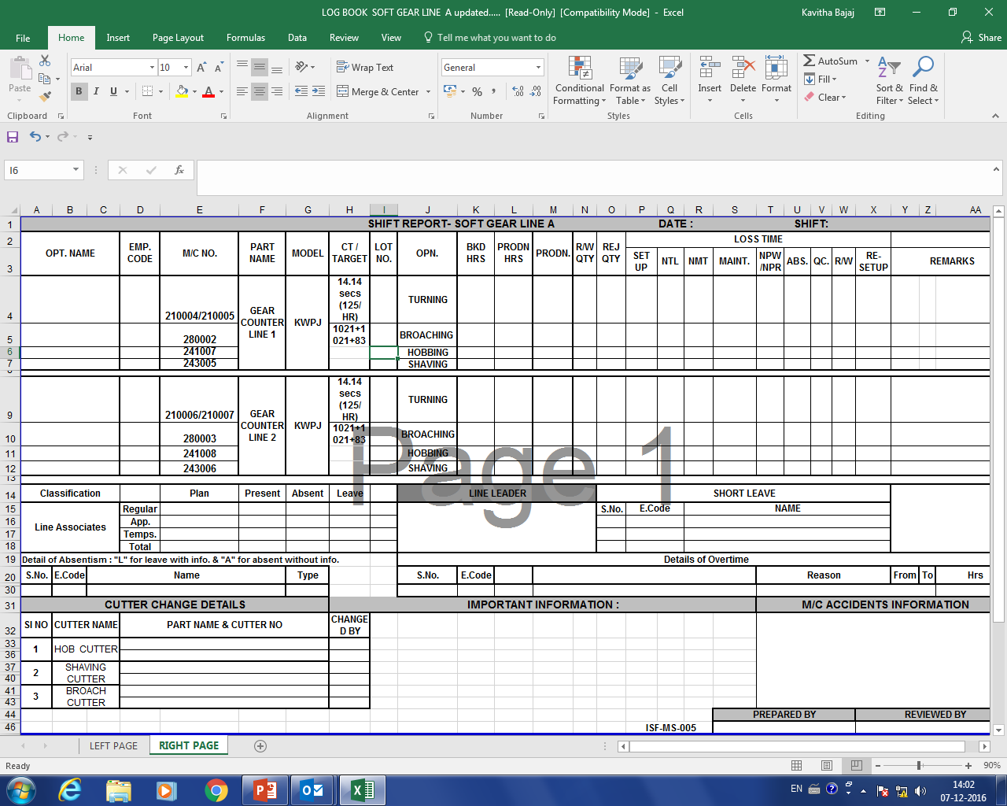
LOG BOOK ENTRY

Slide 23
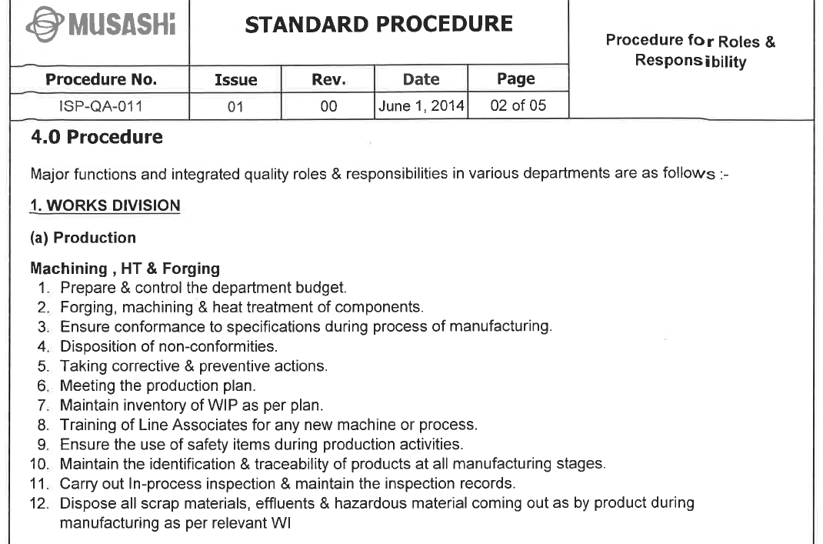
PROCEDURE FOR ROLES & RESPONSIBILITY

Slide 24
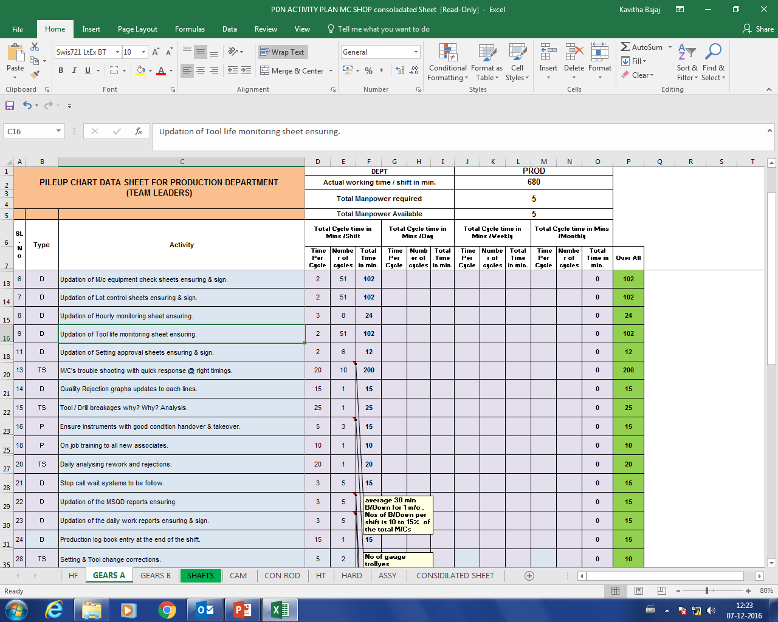
PROCEDURE FOR ROLES & RESPONSIBILITY
LL/TL/TS/ENGG/SR.ENGG

Slide 25

THANK YOU
Keep Learning to improve your Skill level

